Slide 1
Binary rewrite and its application for obfuscation
CS-577-A, Fall 2021
Jun Xu

Slide 2
What is binary re-write
Change the code or data inside a binary file

Slide 3
Why binary re-write
Benign reasons:
--- Preventing reverse engineering
--- Security hardening such as patching bugs
--- Bypass complicated checks in malware
Malicious reasons:
--- Mask the real behaviors of malware
--- Bypass license checks
--- Inject malicious code into benign code
For fun
--- Say you cannot pass a stage in a game …

Slide 4
How to do binary rewrite
Statically: change the binary file on your disk
--- Hard to ensure correctness and safety
--- Permanent change
Dynamically: load the binary into tools like debuggers, and change the code or data in memory
--- Easy to do and no errors
--- You have to do it every time you restart the program

Slide 5
Static binary rewrite: workflow
Binary on disk
Disassembly
Assembly code
Figure out what to change
Locations of targets
Edit
Why do not we directly modify the assembly code and then re-assembly the modified code back to binary code?
Binary on disk

Slide 6
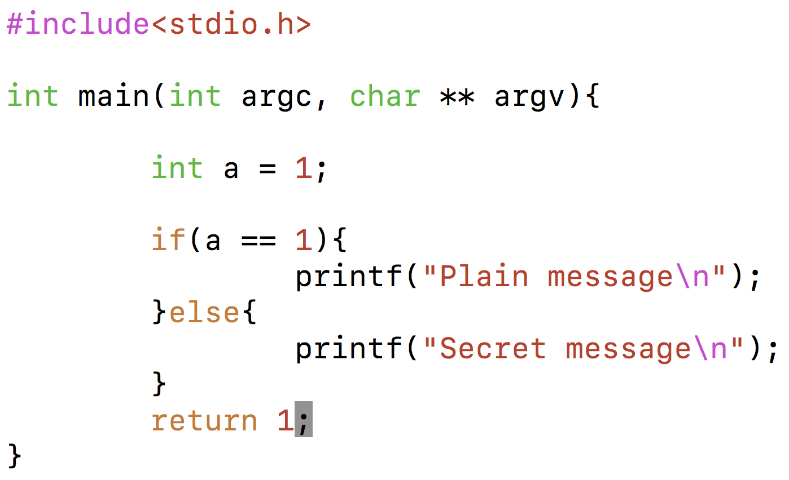
Static binary rewrite (1): modify a single instruction
Binary
Goal: make the binary print “Secret message” when we run it

Slide 7
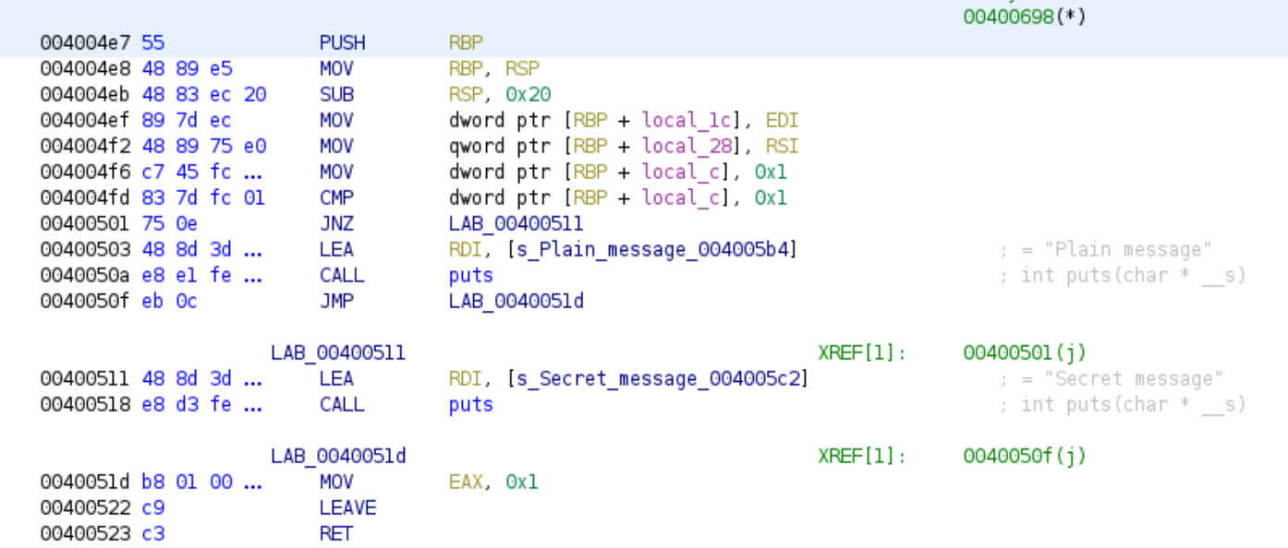
Static binary rewrite (1): modify a single instruction
Binary
Disassembly
This is the instruction doing the comparison;
This instruction actually compares [RBP+local_c] with 0x1, which always evaluates to be true
Let’s change this instruction to compares [RBP+local_c] with 0x2; then it will evaluate to be false

Slide 8
Static binary rewrite (1): modify a single instruction
Where is the instruction in the binary file on the disk?
What we know now is the “memory address” --- the address of the instruction when the binary is loaded into memory --- of the instruction: 0x4004fd;
What we need is the location of the instruction in the binary file, namely offset of this instruction to the beginning of the file

Slide 9
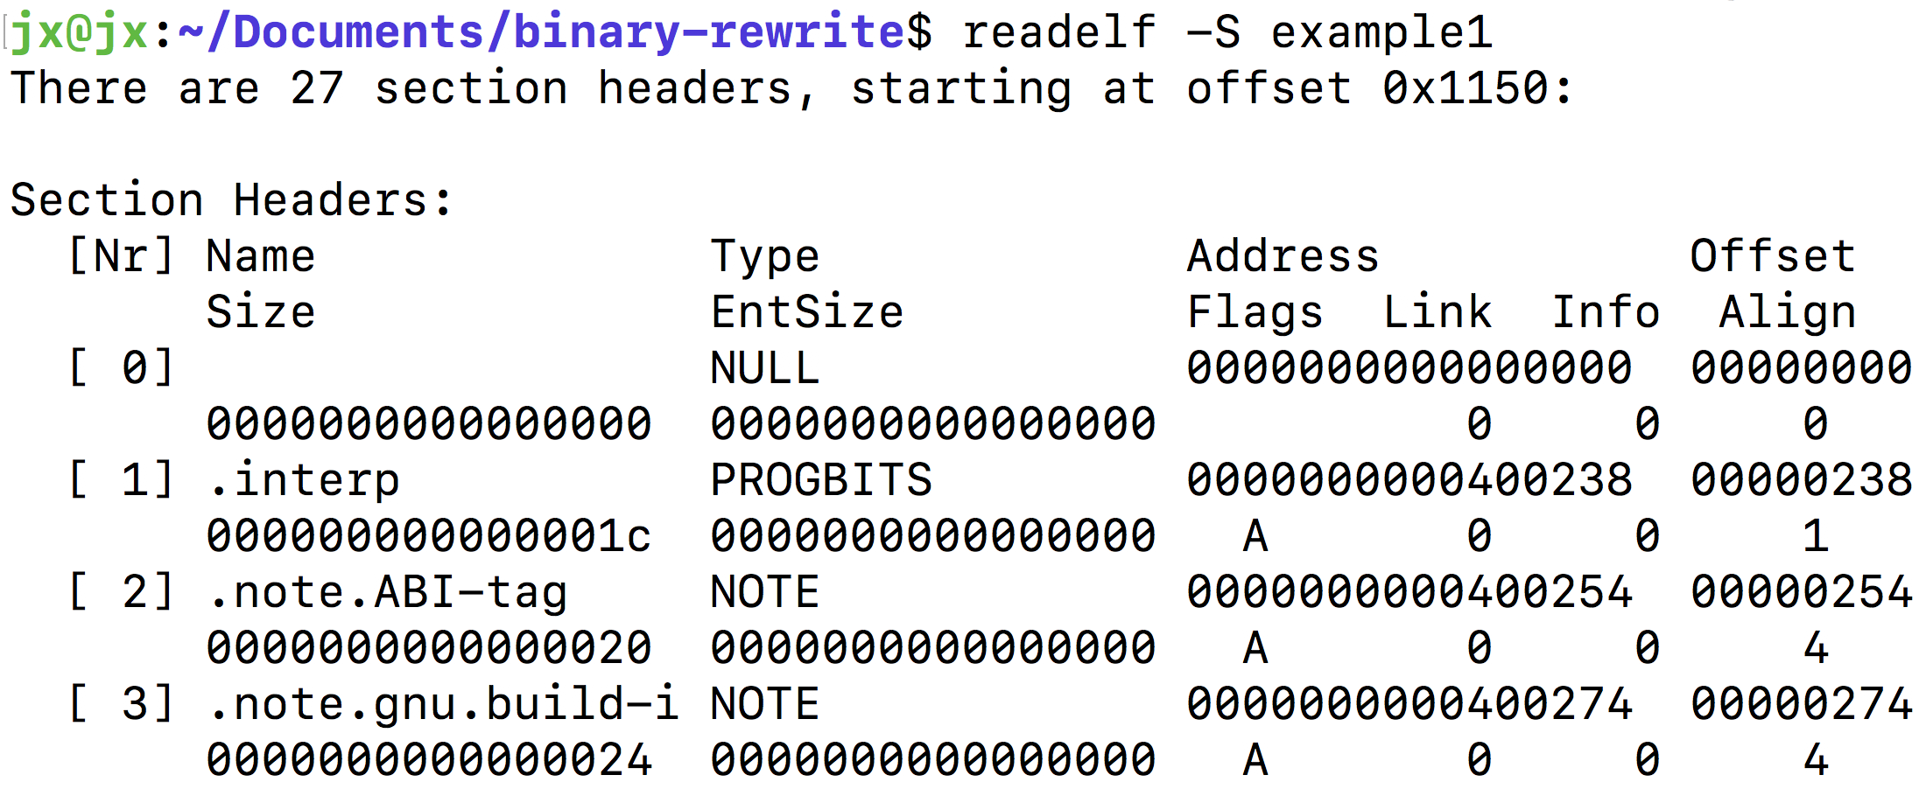
Static binary rewrite (1): modify a single instruction
The ELF file gives the mapping between the memory address and the file offset, at the granularity of section;
We know the file offset for the first byte in each section
For each instruction, its memory address is given by the disassembler; so we can figure out the offset between instruction and the begin of the corresponding section based on their memory addresses. Now we can calculate the file offset.
Memory address of .text: 0x400400
File offset of .text: 0x400
Memory address of our instruction: 0x4004fd
File offset of .text: 0x4004fd - 0x400400 + 0x400 = 0x4fd

Slide 10
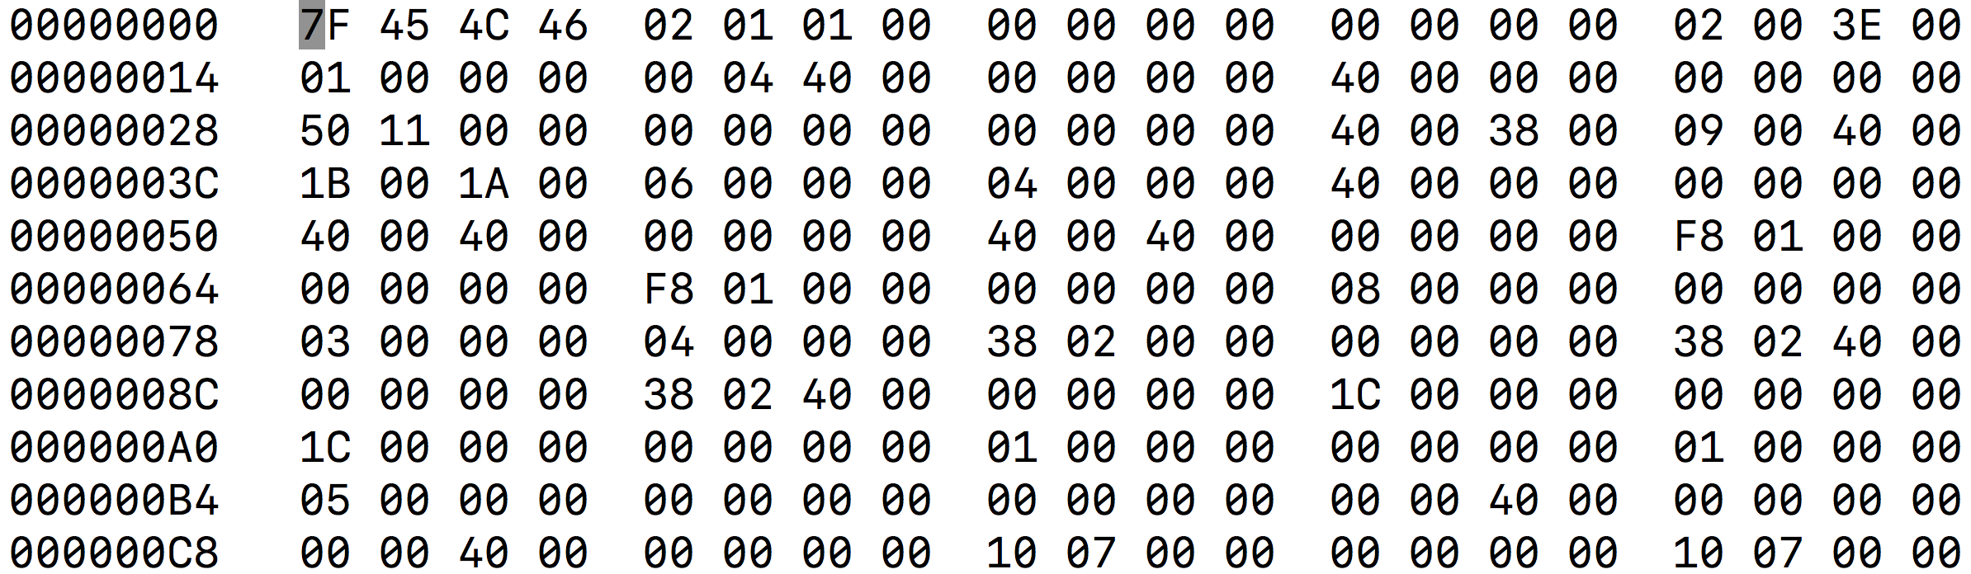
Static binary rewrite (1): modify a single instruction
Binary
hexedit
Find your target offset: 0x4fd
Find your instruction: 83 7d fc 01
Question: how do you know the length of your instruction?

Slide 11
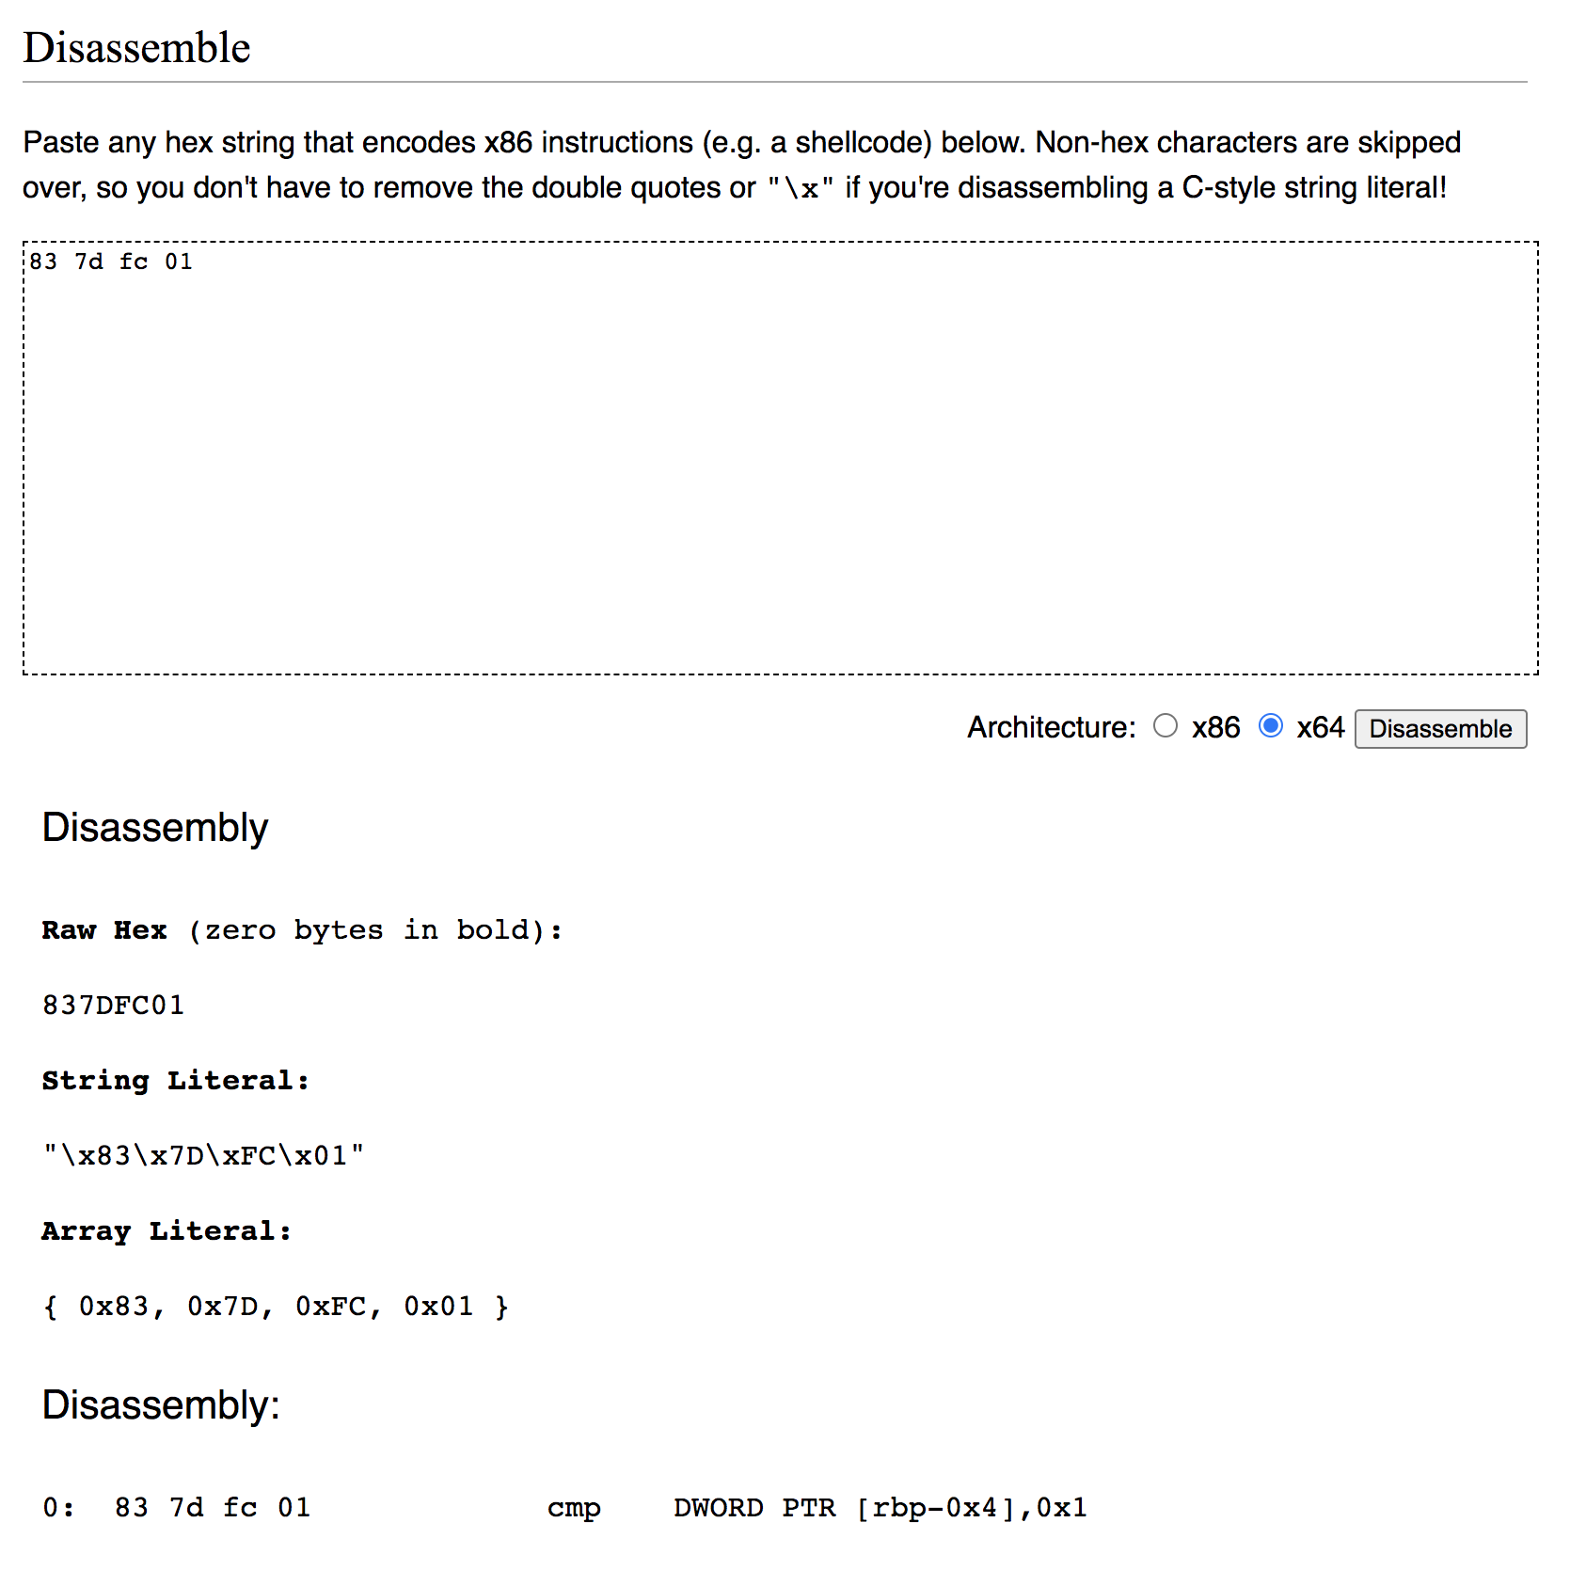
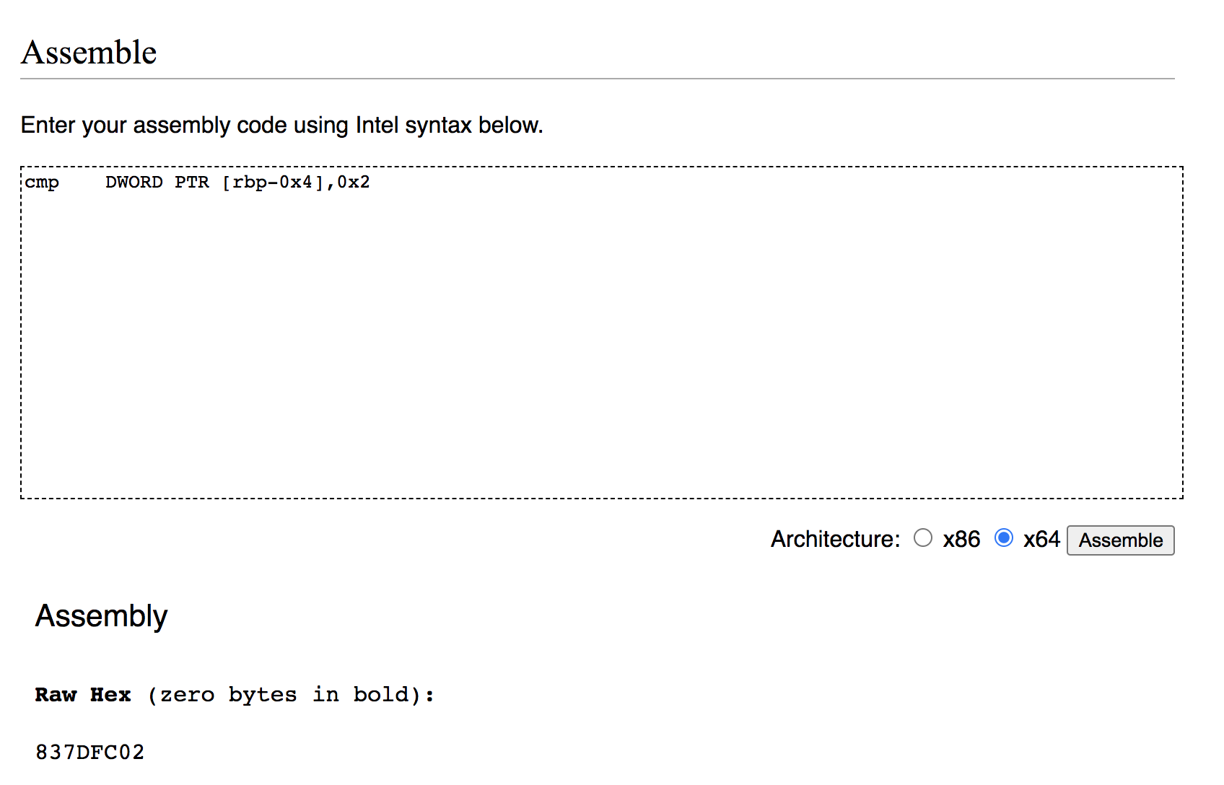
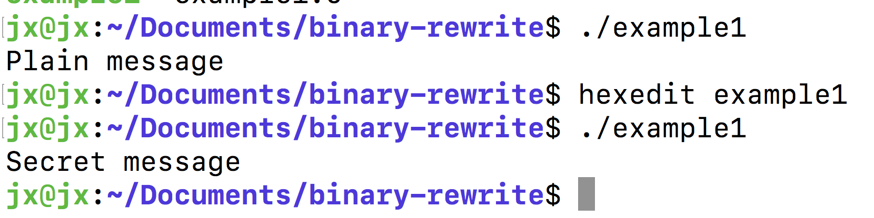
Static binary rewrite (1): modify a single instruction
Copy your raw bytes into an online assembler/disassembly
E.g., https://defuse.ca/online-x86-assembler.htm
Copy the assembly instruction to the assembler;
Make the changes you need;
Assembly the changed instruction;
Copy the raw bytes back to the binary file

Slide 12
Static binary rewrite (1): modify a single instruction
You need to make sure the new instruction has the same length as the original instruction. Why?
Target here
If the new instruction is shorter or longer than the original one, the addresses of all the instruction after the one you modify will be changed… all the references to those instructions will be broken….
.text section
OS ensures the first instruction will be loaded to the expected location;
In this way, the locations of all other instructions can be calculated in the compiling time;
Therefore, every instruction can be referenced based on their calculated addresses

Slide 13
Static binary rewrite (1): modify a single instruction
If the new instruction is shorter
--- You can simply append some “NOP” instructions after the new instruction, to compensate the length
--- NOP will not affect the execution in any way; so it is safe
If the new instruction is longer…
--- Sorry there is no trick to play; you will need a smarter idea

Slide 14
Static binary rewrite (1): modify a single instruction
If the new instruction is longer…
Inst 1
Inst 2
Inst 3
Inst 4
Jmp New_BB, NOP, NOP …
Inst 6
Inst 7
Inst 8
Inst 9
Inst 1
Inst 2
Inst 3
Inst 4
Inst 5 → inst a, b, c, d, e
Inst 6
Inst 7
Inst 8
Inst 9
How to insert the New_BB into the binary file without breaking the other structures is always complicated; But I’ll leave this part as a open question for you guys.
New_BB:
Inst a
Inst b
Inst c
Inst d
Inst e
Jmp Inst-6
You need to replace intst 5 with inst a-e; the latter is much longer

Slide 15
Static binary rewrite (2): modify a group of instructions
No much difference from modifying a single instruction …
But again, you need to make sure the new instructions and the old instructions have the same length

Slide 16
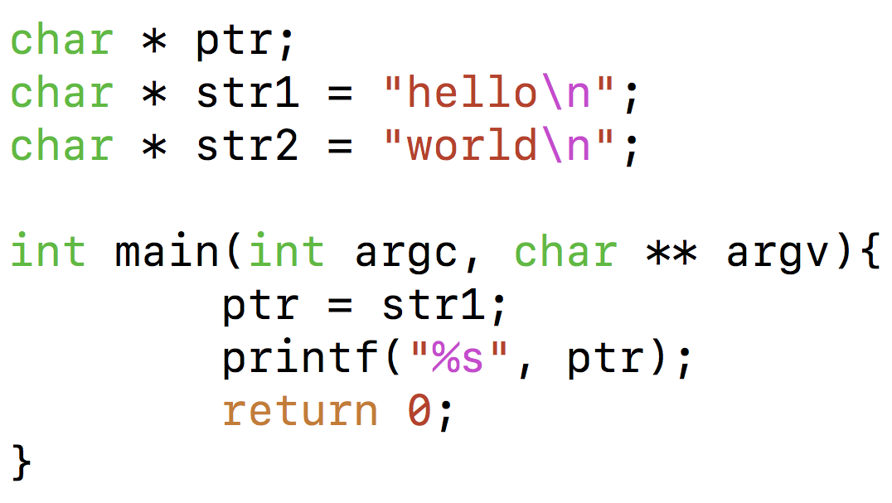
Static binary rewrite (3): modify some pieces of data
Binary
Goal: make the binary print “str2” instead of “str1”

Slide 17
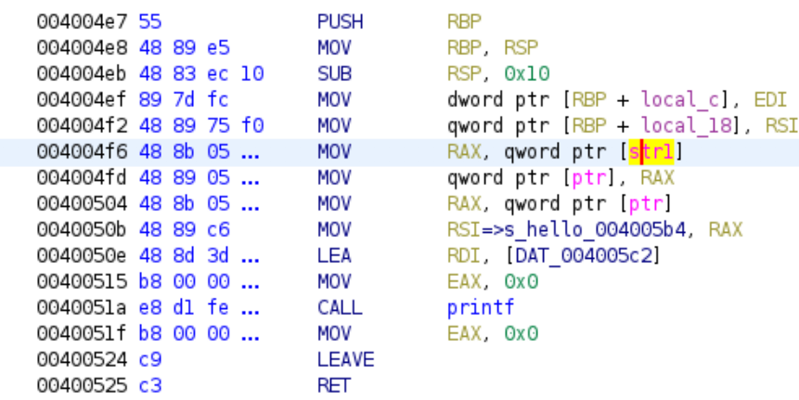
Static binary rewrite (3): modify some data
Binary
Disassembly
This is the instruction loading the pointer: it loads the value from memory location [str1];
The value inside [str1] saves pointer “str1”, namely address of “hello”;
We can change the value inside [str1] to pointer “str2”, namely address of “world”

Slide 18
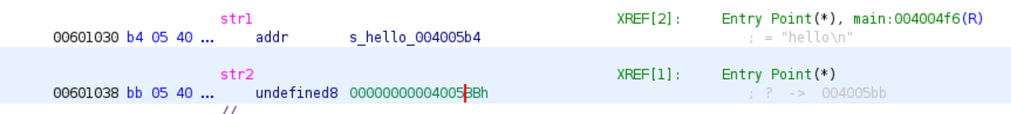
Static binary rewrite (3): modify some data
This is the location of “str1” (note that a pointer in binary code is also a piece of memory, no difference from an integer)
Inside the memory for “str1”, the value is the address of ”hello”; so we just need to change that value to the address of ”world”; but where is “world”? Check the value inside the memory for “str2”

Slide 19
Static binary rewrite (3): modify some data
Where is the data in the binary file on the disk?
Again, what we know now is the “memory address” --- the address of the data when the binary is loaded into memory --- of the data: 0x601030;
What we need is the location of the data in the binary file, namely offset of this data to the beginning of the file

Slide 20
Static binary rewrite (3): modify some data
Memory address of .data: 0x601020
File offset of .data: 0x1020
Memory address of our data: 0x601030
File offset of our data: 0x601030 – 0x601020 + 0x1020 = 0x1030

Slide 21
Static binary rewrite (3): modify some data
Binary
hexedit
Find your target offset: 0x1030
Find your data: 00 00 00 00 00 40 05 b4
Question: how do you know the length of your data?

Slide 22
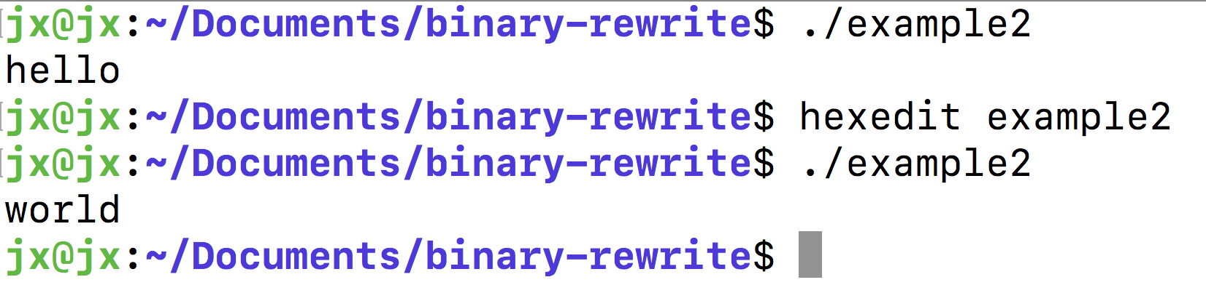
Static binary rewrite (3): modify some data
Change your data

Slide 23
Application of binary rewrite: Binary code obfuscation
Binary code obfuscation is the technique of making the binary code of an application difficult to read and comprehend so it becomes almost impossible for any unauthorized third-party group or individual, using any available tools, to reverse engineer it.
Binary rewrite is one of the technical foundation for obfuscation, in particular when you cannot access the source code and the compilation process.
People do it mainly to prevent reverse engineering to:
--- protect Intellectual Property
--- but also hide malicious behaviors

Slide 24
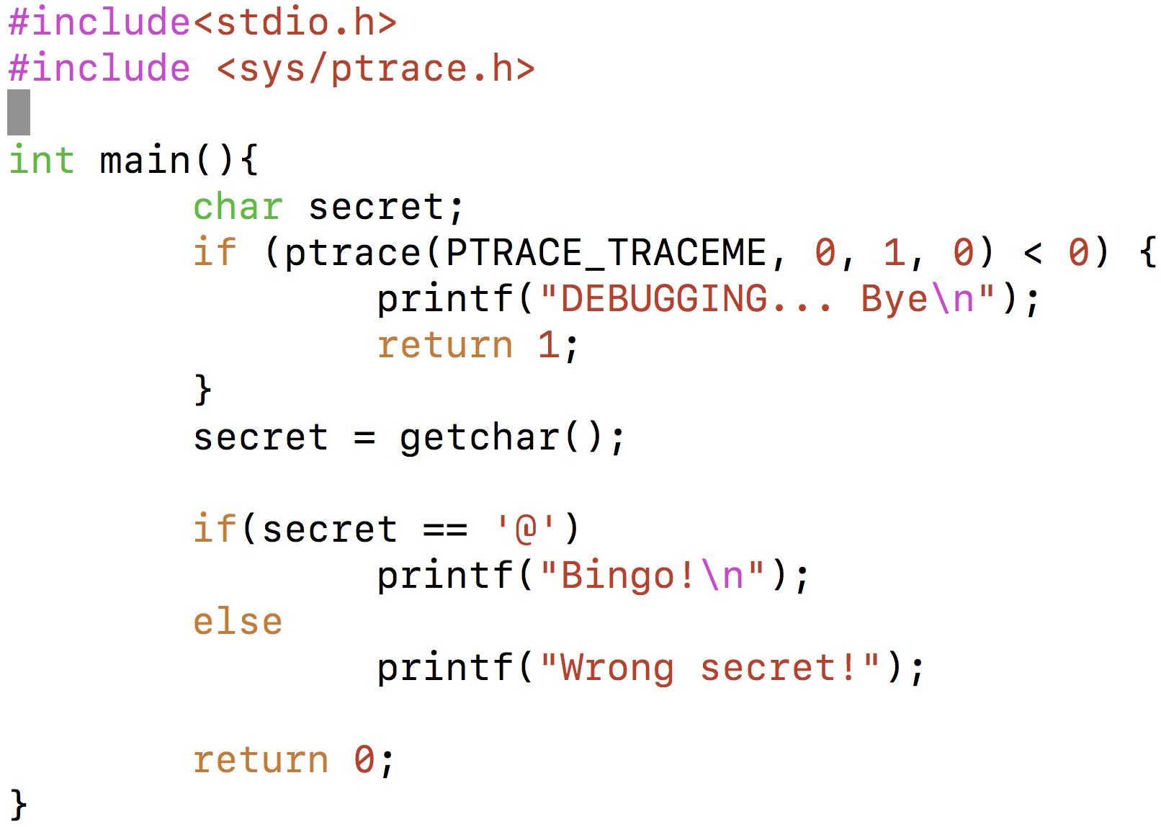
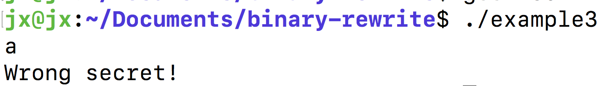
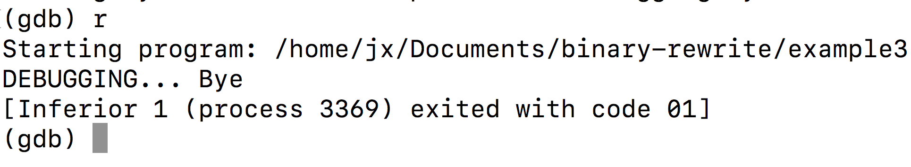
Obfuscation: an example
This piece of code is inserted to obfuscate debugging
If you run this program without GDB, you will be asked for an input and see whether you give the desired secret
Note: in the example, source code is used as it is better for demonstration. The key idea behind the example can be well applied to binary code via binary rewrite.
If you run this program with GDB, nothing will happen

Slide 25
There are many categories of obfuscation techniques
We cannot cover the details for all of them; let’s just take a look at the widely used ones

Slide 26
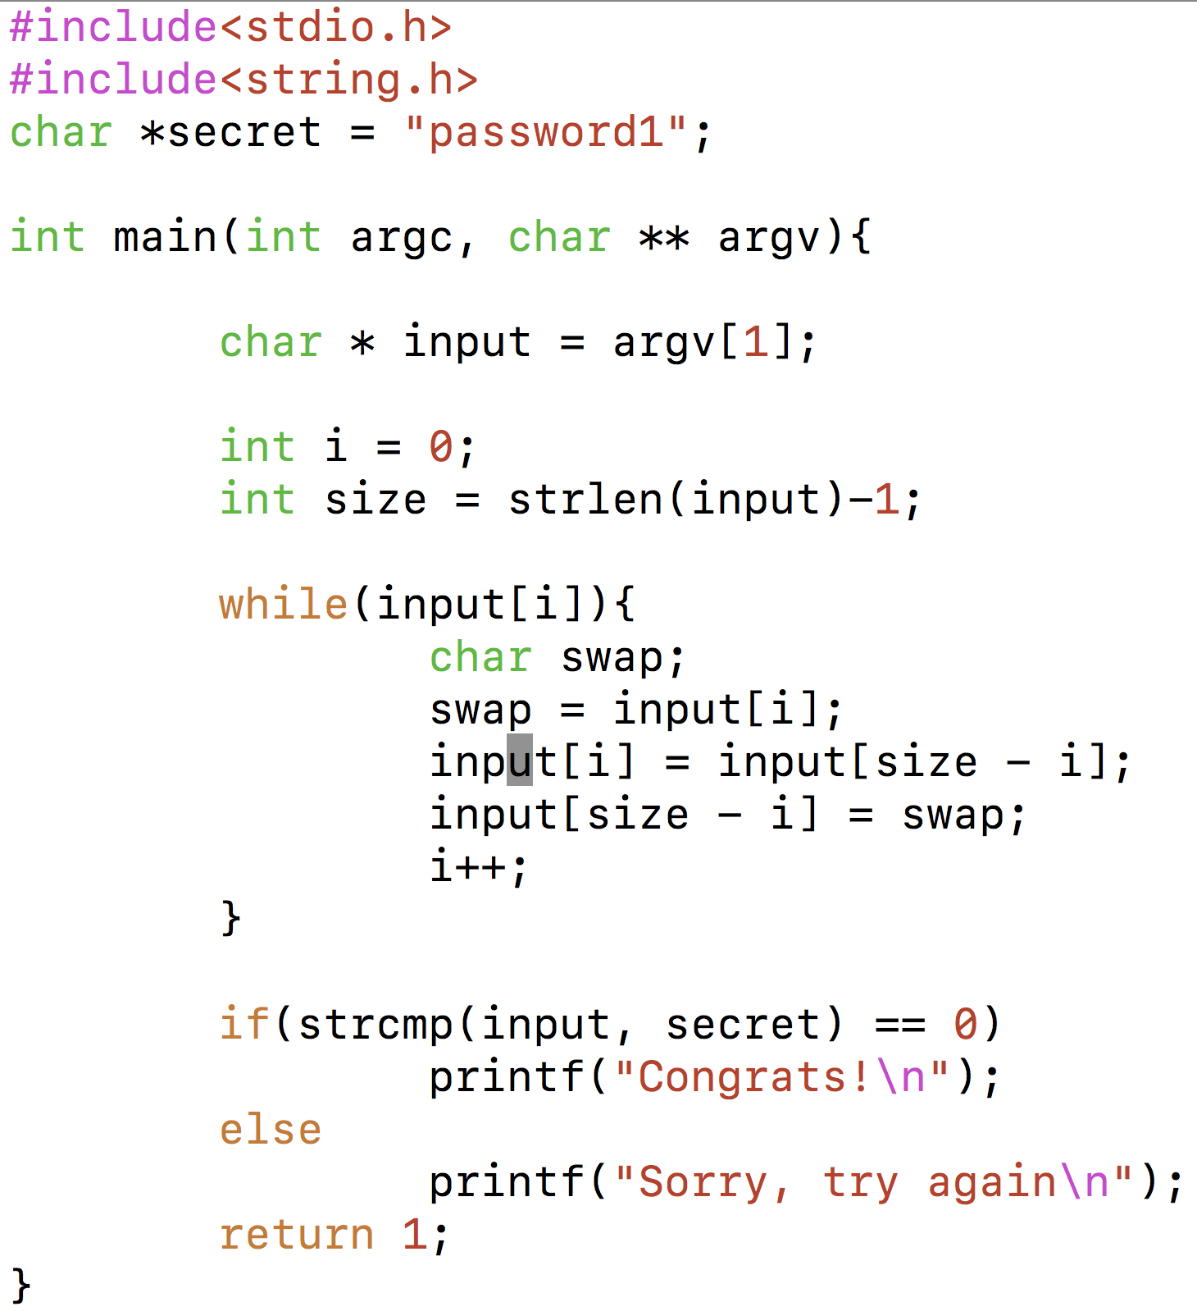
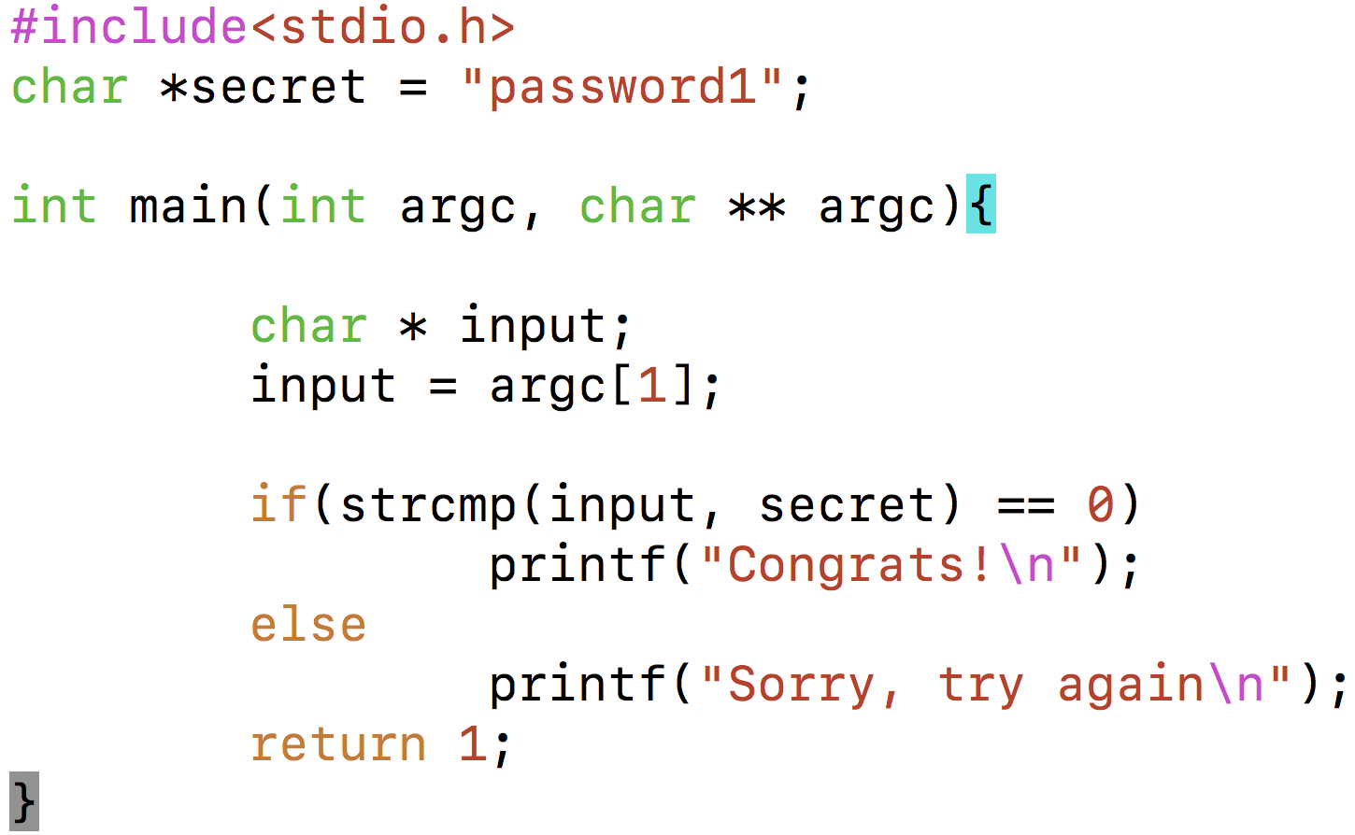
Obfuscation (1): Insert extra but zero-effect code
DUMMY!

Slide 27
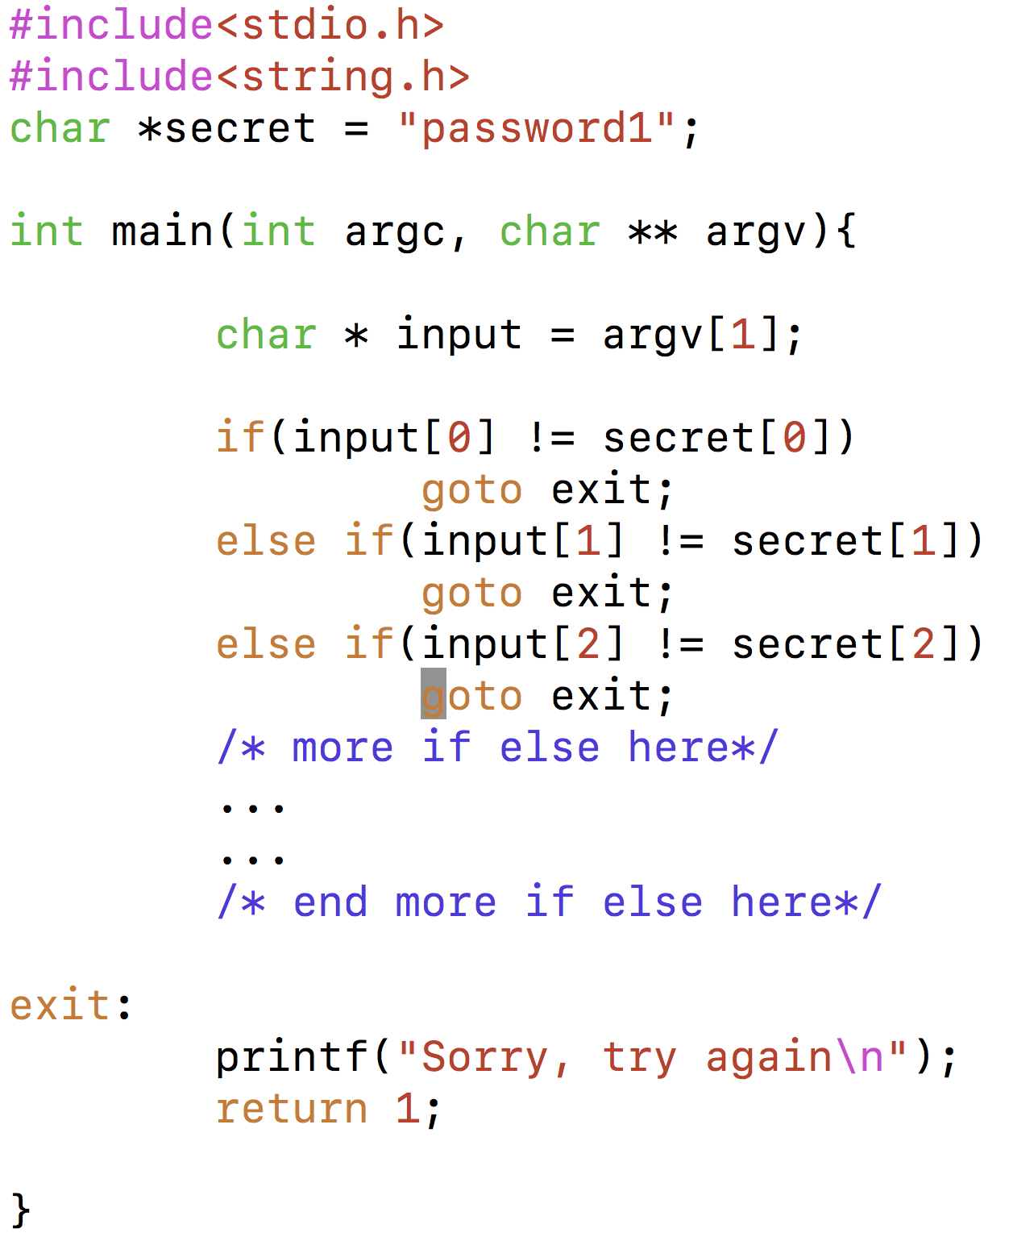
Obfuscation (2): Creating more branches
Now! Tons of branches

Slide 28
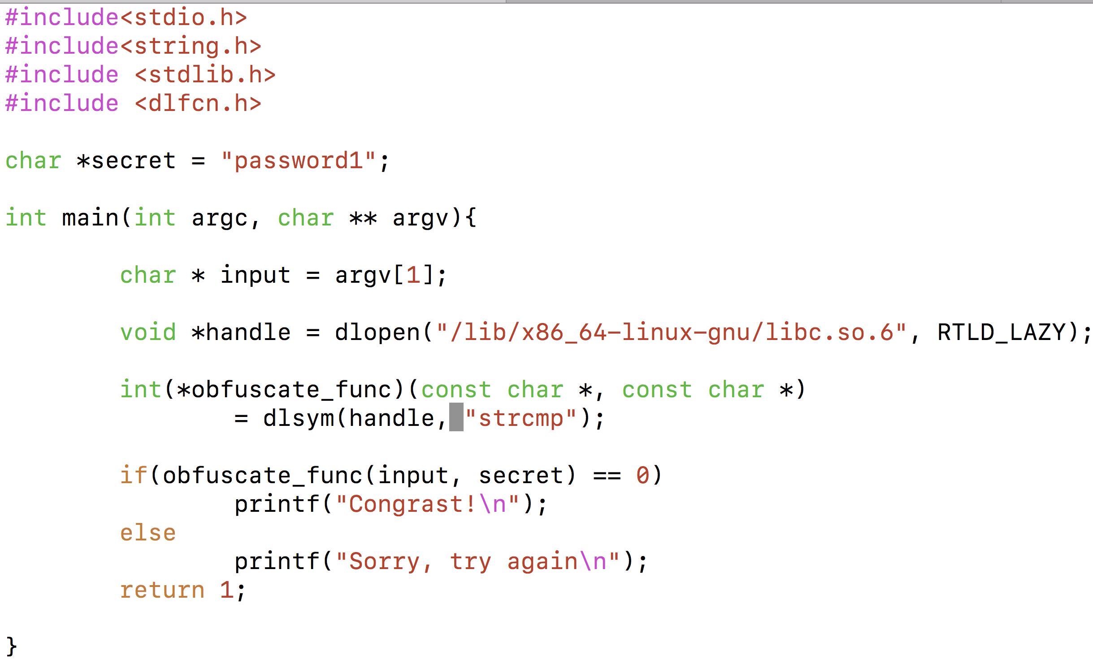
Obfuscation (4): Hiding library functions
We call “strcmp” but in an obfuscated way

Slide 29
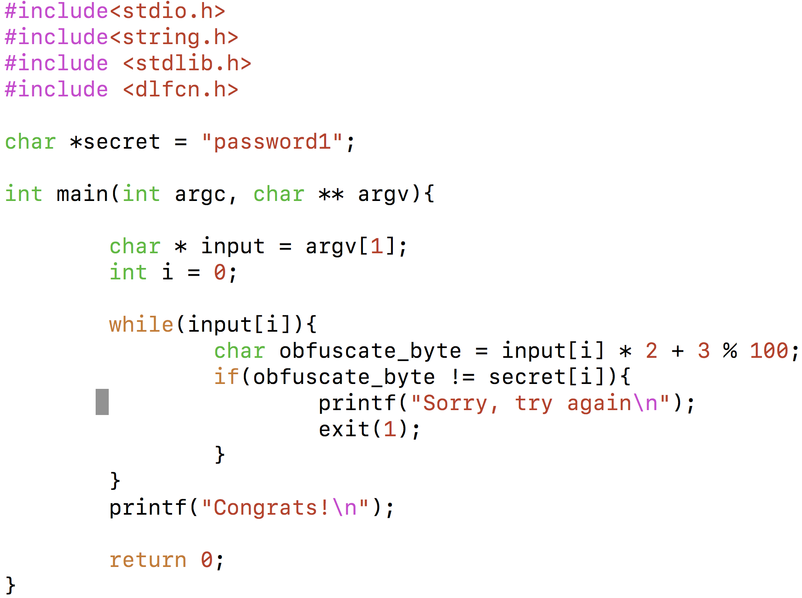
Obfuscation (5): Complicate the logic
Transform the input and then compare with the secret

Slide 30
Obfuscation (5): Compressing or even encrypting the original code
compressed_code
Compress
Int main(){
original_code = malloc(some_byte);
original_code = decompress(compressed_code);
run(original_code);
}
Put the compressed_code and the above code into the same binary file

Slide 31
Obfuscation (5): Compressing or even encrypting the original code
UPX: one of the most commonly used packers that can compress the original binary code and create a new binary file which will decompress + run the original code at run-time
Freely available at https://upx.github.io/
It provides multiple options for a tradeoff between efficiency and strenthen

Slide 32
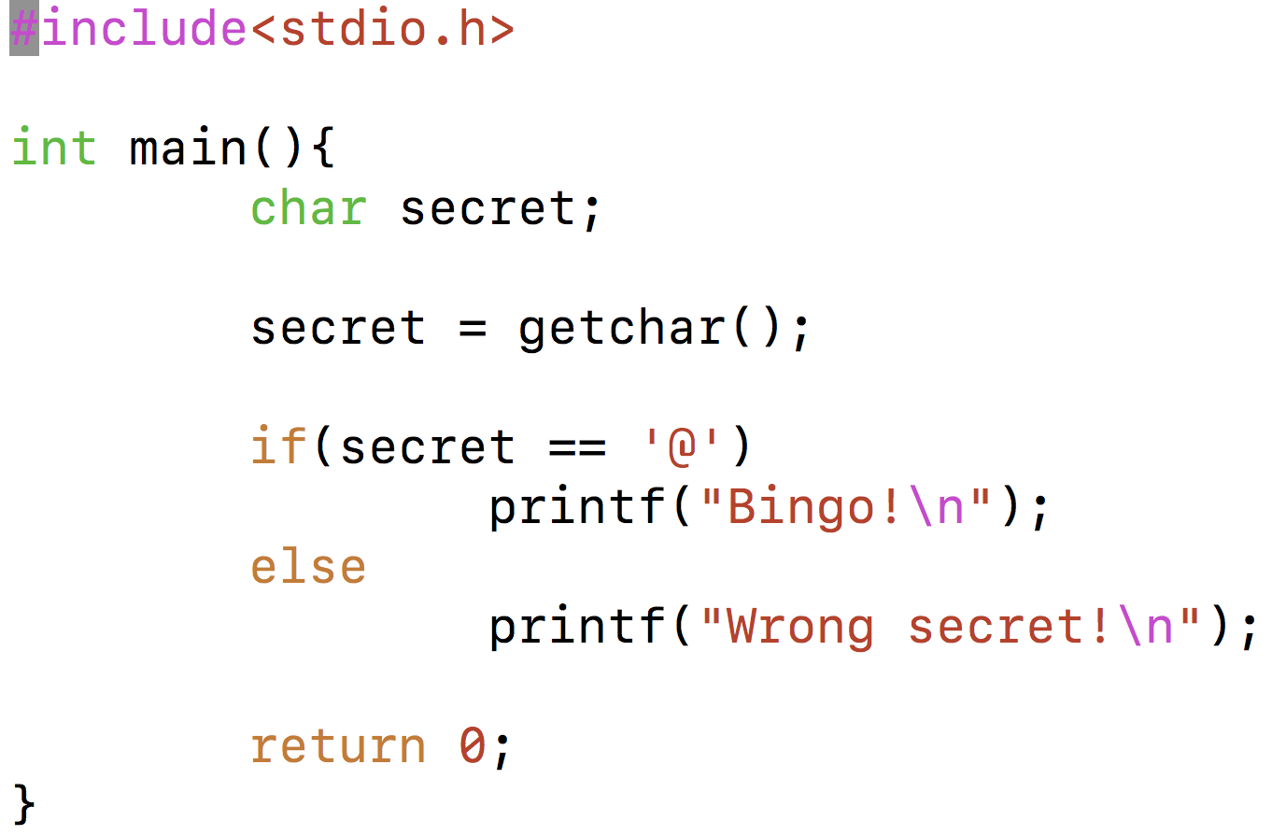
Obfuscation (5): Compressing or even encrypting the original code (an example)
Original Binary
Compile
UPX
UPX Binary

Slide 33
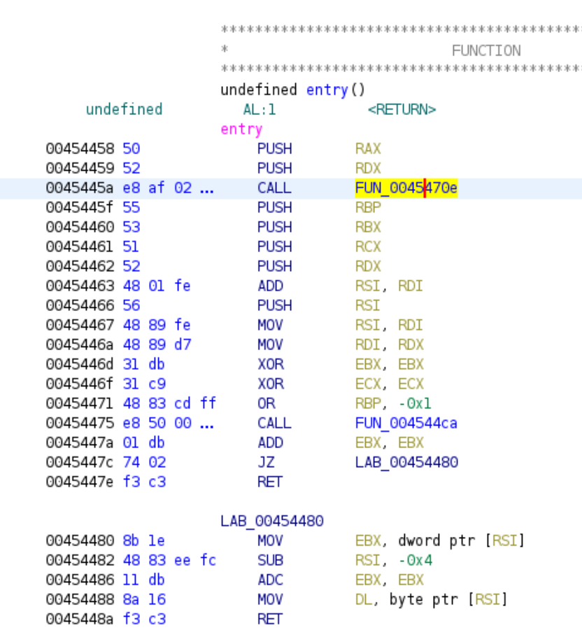
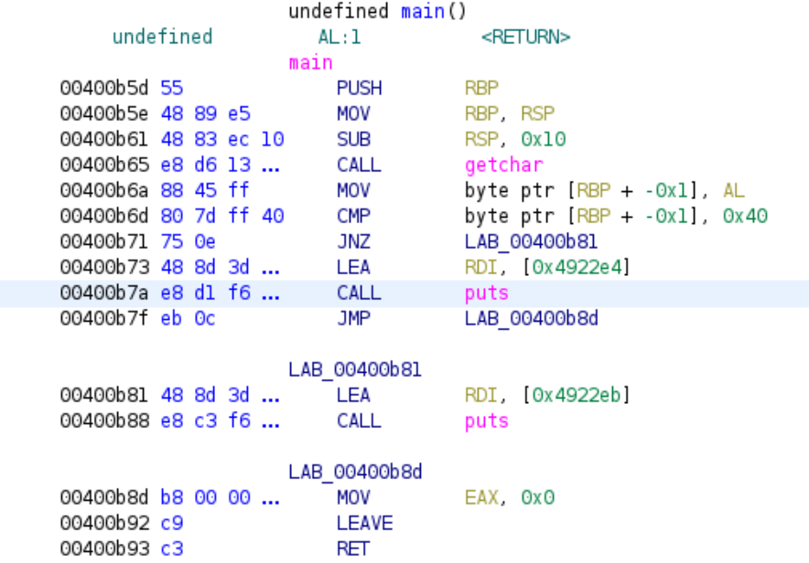
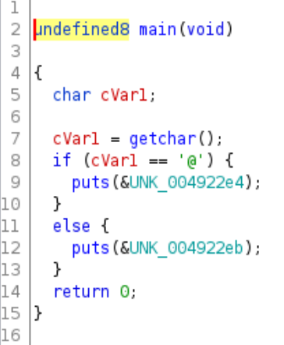
Obfuscation (5): Compressing or even encrypting the original code
After packing by UPX
You won’t even be able to find ”main”
Before packing by UPX

Slide 34
Obfuscation (6): Anti-debugging
This piece of code is inserted to obfuscate debugging
If you run this program without GDB, you will be asked for an input and see whether you give the desired secret
Note: in the example, source code is used as it is better for demonstration. The key idea behind the example can be well applied to binary code via binary rewrite.
If you run this program with GDB, nothing will happen

